Slide 1
Modern Programming Languages
UIIT PMAS Arid Agriculture University, Rawalpindi
Course Instructor: Suleman Khurram

Slide 2
Packages
A package is a uniquely named collection of classes.

Slide 3
Packaging Up Your Classes
Putting one of your classes in a named package is very simple.
You just add a package statement as the first statement in the source file containing the class definition.
package Geometry;
public class Sphere {
// Details of the class definition
}

Slide 4
All the files for classes within a package PackageName must be included in a directory/folder with the name PackageName.
You can use nested directories/folders but in such a case your Package statement will look like following
package Geometry.Shapes3D;

Slide 5
Class access in packages
If you want the classes in a package to be accessible outside the package, you must declare the class using the keyword public in the first line of your class definition.
Class definitions that aren’t preceded by the keyword public are accessible only from methods in classes that belong to the same package.

Slide 6
Compiling a Package
The files in a package can be compiled using the following command
Javac –classpath “package path” fileName.java
For compiling all files in a package
Javac –classpath “package path” *.java

Slide 7
Package Compilation Example
Set your class path
Copy the folder utilities in d drive
Then type the command
D>Javac utilities\*.java

Slide 8
Accessing the packages using extentions
Extensions are .jar files stored within the ext directory that is created when you install the JDK.
The classes and packages in the .jar archives that you place in the ext directory will automatically be accessible when you compile or run your Java programs,

Slide 9
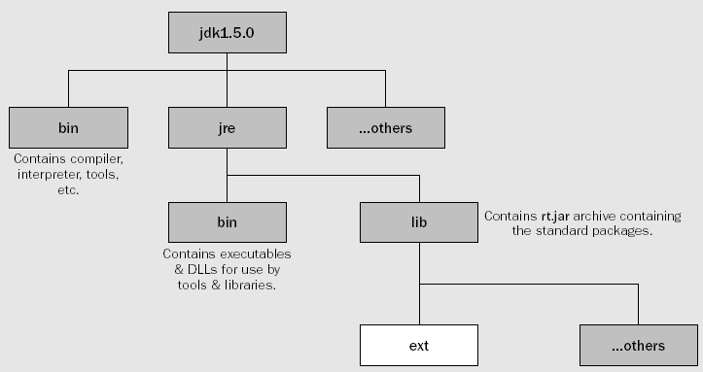

Slide 10
Creating a jar file
You need to execute following command to create a jar file
C:\Beg Java Stuff> jar cvf Geometry.jar Geometry\*.class
Path on your command prompt where the package/ directory resides
Name of the actual directory where all compiled .class files exist
The jar file you want to create

Slide 11
Copy the newly created package to the ext directory to make your classes accessable

Slide 12
Adding Classes from a Package to Your Program
import Geometry.Shapes3D.*; // Include all classes from this package
import Geometry.Shapes3D.Sphere; // Include the class Sphere

Slide 13
Java standard packages
There is a substantial and growing list of standard packages in Java (more than 150 in JDK 5)
Some of them are
java.lang
java.io
javax.swing
java.util
java.applet

Slide 14
Wrapper classes
These are Standard Classes Encapsulating the Primitive Data Types
Boolean, Character, Byte, Short, Integer, Long, Float, Double
These are all contained in the package java.lang
You can create objects of these classes and there are useful utility methods that provide operations on the primitive data types e.g. toString();

Slide 15
Java Inner Classes (Nested Classes)
Java inner class or nested class is a class that is declared inside the class or interface.
We use inner classes to logically group classes and interfaces in one place to be more readable and maintainable.
Additionally, it can access all the members of the outer class, including private data members and methods.

Slide 16
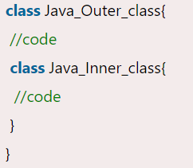
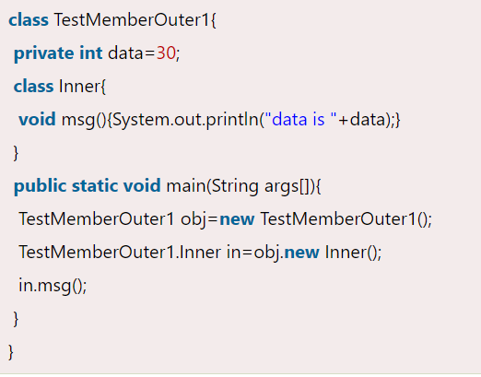
Java Inner Classes (Nested Classes)

Slide 17
Advantage of Java inner classes
There are three advantages of inner classes in Java.
Nested classes represent a particular type of relationship that is it can access all the members (data members and methods) of the outer class, including private.
Nested classes are used to develop more readable and maintainable code because it logically group classes and interfaces in one place only.
Code Optimization: It requires less code to write.

Slide 18
Need of Java Inner class
Sometimes users need to program a class in such a way so that no other class can access it. Therefore, it would be better if you include it within other classes.
If all the class objects are a part of the outer object then it is easier to nest that class inside the outer class. That way all the outer class can access all the objects of the inner class.

Slide 19
Difference between nested class and inner class in Java
An inner class is a part of a nested class. Non-static nested classes are known as inner classes.

Slide 20
Types of Nested classes
There are two types of nested classes non-static and static nested classes. The non-static nested classes are also known as inner classes.
Non-static nested class (inner class)
Member inner class
Anonymous inner class
Local inner class
Static nested class

Slide 21
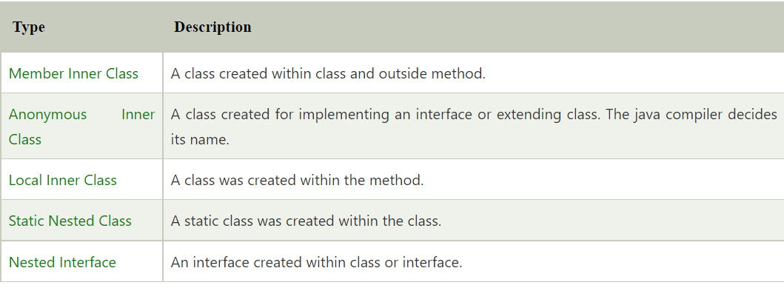
Types of Nested classes
Notes:
A static class is a class that is created inside a class, is called a static nested class in Java. It cannot access non-static data members and methods.
An interface, i.e., declared within another interface or class, is known as a nested interface. The nested interfaces are used to group related interfaces so that they can be easy to maintain.

Slide 22
Java Anonymous inner class
Java anonymous inner class is an inner class without a name and for which only a single object is created.
An anonymous inner class can be useful when making an instance of an object with certain "extras" such as overloading methods of a class or interface, without having to actually subclass a class.
In simple words, a class that has no name is known as an anonymous inner class in Java.

Slide 23
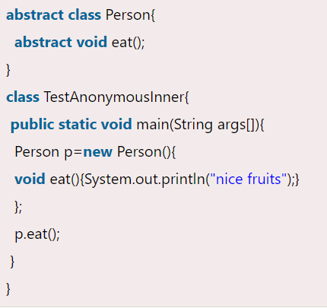
Java Anonymous inner class

Slide 24
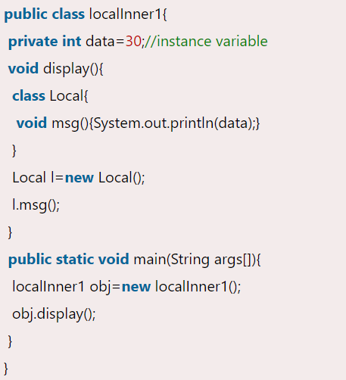
Java Local inner class
A class i.e., created inside a method, is called local inner class in java.

Slide 25
Polymorphism
The word polymorphism generally means the ability to assume several different forms or shapes
In programming terms it means
the ability of a single variable of a given type to be used to reference objects of different types
and to automatically call the method that is specific to the type of object the variable references.
This enables a single method call to behave differently, depending on the type of the object to
which the call applies

Slide 26
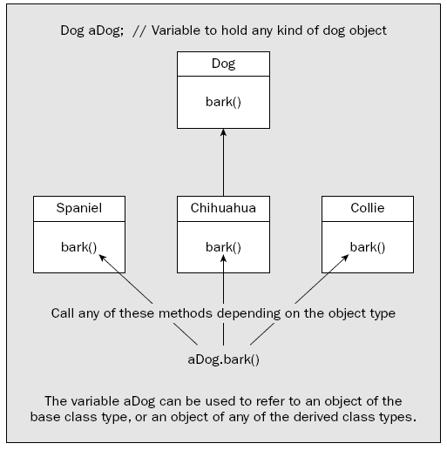

Slide 27
Storing derived class object into base class variable
Up to now you have always been using a
variable of a given type to reference objects of the same type.
You can store a reference to a derived class object in a variable of the derived
class type, but you can also store it in a variable of any direct or indirect base class type

Slide 28
Conditions to meet polymorphism
The method call for a derived class object must be through a variable of a base class type.
The method called must be defined in the derived class.
The method called must also be declared as a member of the base class.
The method signatures for the method in the base and derived classes must be the same.
Either the method return type must be the same in the base and derived classes or the return
type must be covariant.
The method access specifier must be no more restrictive in the derived class than in the base.

Slide 29
Polymorphism applies on methods only
polymorphism applies only to methods.
It does not apply to data members.
When you access a data member of a class object, the variable type always determines the class to which the data member belongs.
This implies that a variable of type Dog can only be used to access data members of the Dog class. Even when it references an object of type Spaniel

Slide 30
Polymorphism Example
Animal
Sound()
Cat
Dog
Duck
Sound()
Sound()
Sound()

Slide 31
Polymorphism Example
import java.util.Random;
public class TryPolymorphism {
public static void main(String[] args) {
// Create an array of three different animals
Animal[] theAnimals = {
new Dog(“Rover”, “Poodle”),
new Cat(“Max”, “Abyssinian”),
new Duck(“Daffy”,”Aylesbury”)
};
Animal petChoice; // Choice of pet
Random select = new Random(); // Random number generator
// Make five random choices of pet
for(int i = 0; i < 5; i++) {
// Choose a random animal as a pet
petChoice = theAnimals[select.nextInt(theAnimals.length)];
System.out.println(“\nYour choice:\n” + petChoice);
petChoice.sound(); // Get the pet’s reaction
}
}
}

Slide 32
Static polymorphism vs Dynamic polymorphism
A polymorphism where object binding with methods happens at compile time is called static polymorphism or compile-time polymorphism.
Static polymorphism can be achieved by method overloading.
A polymorphism where object binding with methods happens at runtime is called runtime polymorphism. In runtime polymorphism, the behavior of a method is decided at runtime.
Dynamic or runtime polymorphism can be achieved or implemented via method overriding in java.

Slide 33
Abstract class
To cater for this, Java has abstract classes. An abstract class is a class in which one or more methods are declared, but not defined.
Since they have no definition and cannot be executed, they are called abstract methods.

Slide 34
Using “final” keyword
If we use the “final” keyword with a method. We can not override this method in any subclass
public final void addPoint(Point point) {
//method body here
}
If we declare a class as final, we prevent any subclasses from being derived from it.
public final class PolyLine {
// Definition as before...
}

Slide 35
Abstract class example
public abstract class Animal {
public abstract void sound(); // Abstract method
public Animal(String aType) {
type = new String(aType);
}
public String toString() {
return “This is a “ + type;
}
private String type;
}

Slide 36
Abstract class
An abstract method cannot be private since a private method cannot be inherited and therefore cannot be redefined in a subclass.
You cannot instantiate an object of an abstract class, but
you can declare a variable of an abstract class type. With the new abstract version of the class Animal, you can still write:
Animal thePet = null; // Declare a variable of type Animal

Slide 37
Abstract class
If you derive a class from an abstract base class, and don’t define all the abstract methods in the subclass then
the subclass will also be abstract and you won’t be able to instantiate any objects of the subclass either.
If a class is abstract, you must use the abstract keyword when you define it, even if it only inherits an abstract method from its super class.

Slide 38
Interfaces
An interface is essentially a collection of related constants and/or abstract methods, and in most cases it will contain just methods.
An interface doesn’t define what a method does. It just defines its form—its name, its parameters, and its return type, so by definition the methods in an interface are abstract.

Slide 39
Interfaces
To make use of an interface, you implement the interface in a class—that is, you declare that the class implements the interface
and you write the code for each of the methods that the interface declares as part of the class definition.
When a class implements an interface, any constants that were defined in the interface definition are available directly in the class, just as though they were inherited from a base class

Slide 40
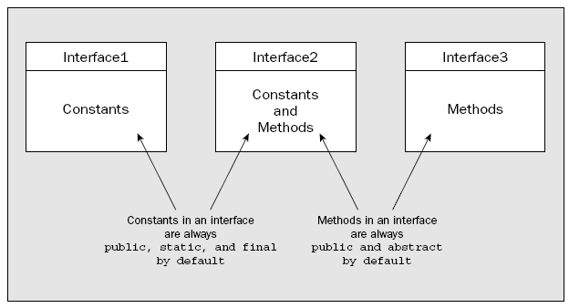
Interfaces
The methods declared in an interface can never be static, so an interface always declares instance methods

Slide 41
Interface Example
public interface Conversions {
double inchesToMillimeters (double inches);
double ouncesToGrams(double ounces);
double poundsToGrams(double pounds);
double hpToWatts(double hp);
double wattsToHP(double watts);
}
public class MyClass implements Conversions {
// Implementations for the methods in the Conversions interface
// Definitions for the other class members...
}

Slide 42
Implementing more then one interface
public class MyClass implements Conversions, Definitions, Detections {
// Definition of the class including implementation of interface methods
}

Slide 43
Encapsulating Constants in a Program
public interface ConversionFactors {
double INCH_TO_MM = 25.4;
double OUNCE_TO_GRAM = 28.349523125;
double POUND_TO_GRAM = 453.5924;
double HP_TO_WATT = 745.7;
double WATT_TO_HP = 1.0/HP_TO_WATT;
}
Constants in an interface are always public, static and final by default

Slide 44
Using constants defined in an interface
public class MyClass {
public static double poundsToGrams(double pounds) {
return pounds*ConversionFactors.POUND_TO_GRAM;
}
// Plus the rest of the class definition...
}
public class MyOtherClass implements ConversionFactors {
public static double poundsToGrams(double pounds) {
return pounds*POUND_TO_GRAM;
}
// Plus the rest of the class definition...
}

Slide 45
Partial interface implementation
You can omit the implementation of one or more of the methods from an interface in a class that implements the interface,
but in this case you would need to declare the class itself as abstract:
public interface Convert {
public void myMethod1();
public void myMethod2();
}
abstract public class interfaceExample implements Convert{
public void myMethod1(){
}
}

Slide 46
Extending Interfaces
public interface ConversionFactors {
double INCH_TO_MM = 25.4;
double OUNCE_TO_GRAM = 28.349523125;
double POUND_TO_GRAM = 453.5924;
double HP_TO_WATT = 745.7;
double WATT_TO_HP = 1.0/HP_TO_WATT;
}
public interface Conversions extends ConversionFactors {
double inchesToMillimeters (double inches);
double ouncesToGrams(double ounces);
double poundsToGrams(double pounds);
double hpToWatts(double hp);
double wattsToHP(double watts);
}

Slide 47
Multiple Inheritance
Unlike a class, which can extend only one other class, an interface can extend any number of other interfaces.
public interface MyInterface extends HisInterface, HerInterface {
// Interface members – constants and abstract methods...
}

Slide 48
Polymorphism and Interfaces
Same as polymorphism with class

Slide 49
Exercise
class A {
void m1(A a){
System.out.println("m1 method in class A");
} }
class B extends A {
public void m1(A a){
System.out.println("m1 method in class B");
} }
public class Test{
public static void main(String[] args){
A a = new A();
a.m1(a);
a.m1(new B());
B b = new B();
b.m1(null);
a = b;
a.m1(null);
a.m1(new A());
} }
Notes:
m1 method in class A m1 method in class A m1 method in class B m1 method in class B m1 method in class B

Slide 50
Exercise
Ans: Yes, the code will be compiled successfully. The output is given below:
m1 method in class A m1 method in class A m1 method in class B m1 method in class B m1 method in class B

Slide 51
Exercise
class A {
void m1(String x){
System.out.println("One");
}
}
class B extends A {
public void m1(String x){
System.out.println("Two");
super.m1(null);
}
}
public class Test{
public static void main(String[] args){
A a = new B();
a.m1(null);
}
}
Notes:
The output is Two, One.

Slide 52
Exercise
class A {
void m1(String x){
System.out.println("One");
}
}
class B extends A {
public void m1(String x){
System.out.println("Two");
super.m1(null);
}
}
public class Test{
public static void main(String[] args){
A a = new B();
a.m1(null);
}
}
Output: The output is Two, One.
Notes:
The output is Two, One.

Slide 53
Exercise
class A {
void m1(String x){
System.out.println("One");
}
}
class B extends A {
}
public class Test{
public static void main(String[] args){
A a = new B();
a.m1(new A());
}
}
Notes:
The method m1(String) in type A is not applicable for the arguments (A).

Slide 54
Exercise
class A {
void m1(String x){
System.out.println("One");
}
}
class B extends A {
}
public class Test{
public static void main(String[] args){
A a = new B();
a.m1(new A());
}
}
Output: The method m1(String) in type A is not applicable for the arguments (A).
Notes:
The method m1(String) in type A is not applicable for the arguments (A).

